Slide 1
Greedy Algorithms
Make choice based on immediate rewards rather than looking ahead to see the optimum
In many cases this is effective as the look ahead variation can require exponential time as the number of possible factors combine
Best way to get to a destination?
Without other knowledge, going down the road that heads in the direction of the destination is probably a reasonable choice
This is the greedy approach and can do well in some cases
It also makes the decision much easier than considering all possible future alternatives
May not be the optimal decision, in contrast to considering all possible alternatives and then subsequent alternatives, etc.

Slide 2
Next Move in Chess
What move should you do next
Could do move which leaves you in the best material position after one move, standard greedy approach
Greedy since it takes best now without considering the ramifications of what could occur later
Could do a 2nd order greedy approach
Look two moves ahead
More time consuming
Better?
N^{th} order greedy? – until game decided
No longer greedy since consider full situation
Exponential time required
Notes:
Greedy usually does just 1st order

Slide 3
Coins Problem
Given:
An unbounded supply of coins of specific denominations
An integer c
Find: Minimal number of coins that add up to c
What is your greedy algorithm?

Slide 4
Coins Algorithm
Repeat until sum = c
Add the largest coin which does not cause sum to exceed c
Does this work and is it Optimal?
Assume denominations are 50¢, 20¢, 3¢, 2¢
Try it with goal of 75¢, 60¢
Now assume denominations are 50¢, 20¢, 3¢, 1¢
Greedy Philosophy
Build up a solution piece by piece
Always choose the next piece that offers the most obvious and immediate benefit
Without violating given constraints
Notes:
Might could do optimal greedy algorithm for denomination variant but would need to compute some more constraints. Grab largest unless remaining difference to number is…

Slide 5
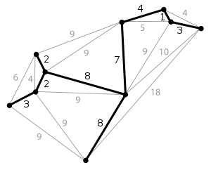
MST – Minimum Spanning Tree
Given a connected undirected graph we would like to find the “cheapest” connected version of that graph
Remove all extra edges, leaving just enough to be connected (V-1) – it will be a tree
Given G = (V, E), find the tree T = (V, E') where E' ⊆ E which minimizes the sum of the edge lengths
Not necessarily unique
Many applications – cheapest phone network, etc.
Notes:
Note any node could be the root.
Show graph on board and then need to start removing edges. Better just use the next slide and ask for algs

Slide 6
MST – Minimum Spanning Tree
What greedy algorithm might we use assuming we start with the entire graph
1
2
1
2
3
6
5
4
4
6
3
8
4
5
6
7
4
3
7
Notes:
Try one – Take the biggest link away that does not disconnect the graph – Greedy? Yes
2 things needed – edge order and is it still connected.
Just sort edges by length
How long to check for disconnectedness – Could do explore O(E) each time (E), Stop when E = V-1, but doing it would be too expensive E*E.
Will it yield an MST? Not sure, How to prove – counterexample, otherwise seek a formal proof

Slide 7
MST – Minimum Spanning Tree
What greedy algorithm might we use assuming we start with the entire graph
Iteratively take away the biggest remaining edge in the graph which does not disconnect the graph
Is it a greedy approach?
Complexity?
How do we prove if it works/optimal or not
Counterexamples – natural first attempt
If no easily found counterexamples, we then seek a more formal proof
1
2
1
2
3
4
6
4
5
6
3
8
4
5
6
4
7
3
7
Notes:
This algorithm was also givem by Kruskal in his Kruskal algorithm and he called it reverse-delete. It does give MST but is slower than Kruskals
Before go to Kruskal's have them figure out their bottom up version
Try one – Take the biggest link away that does not disconnect the graph – Greedy? Will it yield an MST?
How to test for connectedness. E*explore to make sure all nodes reached. Stop when V-1 edges remain. (V+E)*E, E^2 since connected – too slow
If build bottom, might be able to do that easier.
How to prove – counterexample, otherwise seek a formal proof

Slide 8
Kruskal's Algorithm
Sometimes greedy algorithms can also be optimal!
Kruskal's is a simple greedy optimal algorithm for MST
Start with an empty graph
Repeatedly add the next smallest edge from E that does not produce a cycle
How might we test for cycles and what would the complexity be? – more efficient data structure?
Notes:
Crew-skal - Before go to Kruskal's have them figure out their bottom up version – then go to this slide before discussing complexity
Just like with our top down, we had to decide if it was connected with Kruskals we have to
know when there is not a cycle created (without having to do a full dfs each time). Kruskal's is a nice alg to do that.
E*dfs (and check for backedges). (V+E)*E – too slow

Slide 9
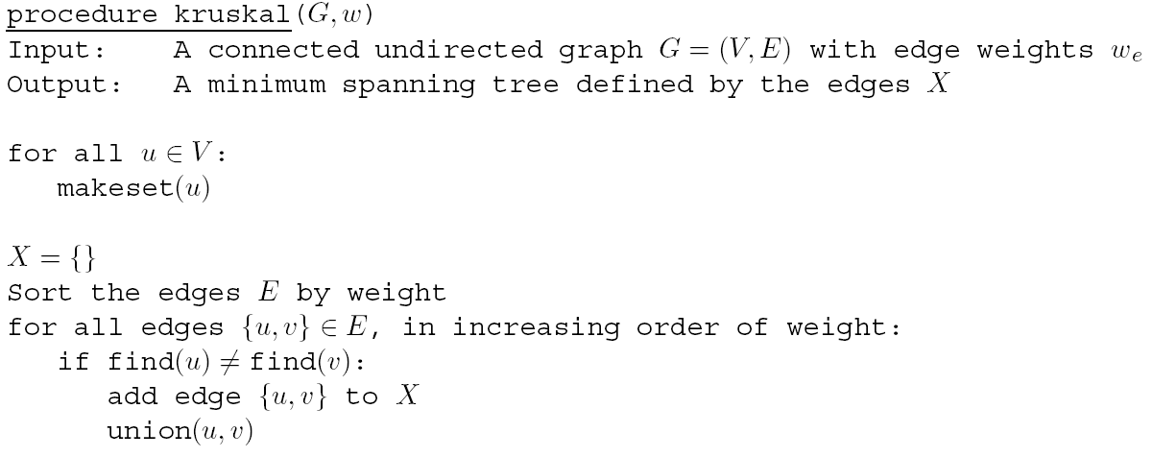
Kruskal's Algorithm
find(u) = find(v) if u and v are in the same set, which means they are in the same connected component
Why not add edge {u,v} if both are in the same set?
Represents nodes in disjoint sets
makeset(u): create a singleton set containing just u
find(u): to which set does u belong?
union(u,v): merge the sets containing u and v
Notes:
Again – data structure/alg mix saves the day
Save complexity for later slide
Would create a cycle - Give intuition of union/cycles

Slide 10
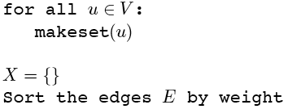
Kruskal’s Algorithm
Make a disjoint set for each vertex
1
2
1
2
3
{1}{2}{3}{4}{5}{6}{7}
6
5
4
4
6
3
8
4
5
6
7
4
3
7
Notes:
Each vertex goes into a separate connected component.
We'll show X on the graph (colored edges), Each color will represent a connected component

Slide 11
Kruskal’s Algorithm
Sort edges by weight
1
2
1
2
3
1: (1,2)
{1}{2}{3}{4}{5}{6}{7}
2: (2,3)
6
5
4
4
6
3: (4,5)
3
8
3: (6,7)
4
5
6
4: (1,4)
4: (2,5)
7
4
3
4: (4,7)
5: (3,5)
7
Notes:
Goal: Visually walk through Kruskal’s algorithm running on this simple graph. This simple enumerates the steps
starting with the sorting.

Slide 12
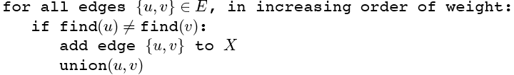
Kruskal’s Algorithm
Add first edge to X if no cycle created
1
2
1
2
3
1: (1,2)
{1}{2}{3}{4}{5}{6}{7}
2: (2,3)
6
5
4
4
6
3: (4,5)
3
8
3: (6,7)
4
5
6
4: (1,4)
4: (2,5)
7
4
3
4: (4,7)
5: (3,5)
7
Notes:
Add the edge with the lowest cost to the solution set X which does not create a cycle.

Slide 13
Kruskal’s Algorithm
Merge vertices in added edges
1
2
1
2
3
1: (1,2)
{1,2}{3}{4}{5}{6}{7}
2: (2,3)
6
5
4
4
6
3: (4,5)
3
8
3: (6,7)
4
5
6
4: (1,4)
4: (2,5)
7
4
3
4: (4,7)
5: (3,5)
7
Notes:
The two vertices that are in the edge are merged into the same connected component

Slide 14
Kruskal’s Algorithm
Process each edge in order
1
2
1
2
3
1: (1,2)
{1,2}{3}{4}{5}{6}{7}
2: (2,3)
{1,2,3}{4}{5}{6}{7}
6
5
4
4
6
3: (4,5)
3
8
3: (6,7)
4
5
6
4: (1,4)
4: (2,5)
7
4
3
4: (4,7)
5: (3,5)
7
Notes:
The next following slides show who each edge is added to T. The issue of always merging separate connected
Components is delayed until we try to add an edge that creates a cycle.

Slide 15
Kruskal’s Algorithm
1
2
1
2
3
1: (1,2)
{1,2}{3}{4}{5}{6}{7}
2: (2,3)
{1,2,3}{4}{5}{6}{7}
6
5
4
4
6
3: (4,5)
{1,2,3}{4,5}{6}{7}
3
8
3: (6,7)
4
5
6
4: (1,4)
4: (2,5)
7
4
3
4: (4,7)
5: (3,5)
7
Note that each set is a connected component of G
Notes:
different color for each non-singleton set/connected component

Slide 16
Kruskal’s Algorithm
1
2
1
2
3
1: (1,2)
{1,2}{3}{4}{5}{6}{7}
2: (2,3)
{1,2,3}{4}{5}{6}{7}
6
5
4
4
6
3: (4,5)
{1,2,3}{4,5}{6}{7}
3
8
3: (6,7)
{1,2,3}{4,5}{6,7}
4
5
6
4: (1,4)
4: (2,5)
7
4
3
4: (4,7)
5: (3,5)
7

Slide 17
Kruskal’s Algorithm
1
2
1
2
3
1: (1,2)
{1,2}{3}{4}{5}{6}{7}
2: (2,3)
{1,2,3}{4}{5}{6}{7}
6
5
4
4
6
3: (4,5)
{1,2,3}{4,5}{6}{7}
3
8
3: (6,7)
{1,2,3}{4,5}{6,7}
4
5
6
4: (1,4)
{1,2,3,4,5}{6,7}
4: (2,5)
7
4
3
4: (4,7)
5: (3,5)
7

Slide 18
Kruskal’s Algorithm
Must join separate components
1
2
1
2
3
1: (1,2)
{1,2}{3}{4}{5}{6}{7}
2: (2,3)
{1,2,3}{4}{5}{6}{7}
6
5
4
4
6
3: (4,5)
{1,2,3}{4,5}{6}{7}
3
8
3: (6,7)
{1,2,3}{4,5}{6,7}
4
5
6
4: (1,4)
{1,2,3,4,5}{6,7}
4: (2,5)
rejected
7
4
3
4: (4,7)
5: (3,5)
7
Notes:
Note that this edge would create a cycle, so it is rejected and not part of T.

Slide 19
Kruskal’s Algorithm
Done when all vertices in one set. Then they are all connected with
exactly |V| - 1 edges. Book version just goes until all edges considered.
1
2
1
2
3
1: (1,2)
{1,2}{3}{4}{5}{6}{7}
2: (2,3)
{1,2,3}{4}{5}{6}{7}
6
5
4
4
6
3: (4,5)
{1,2,3}{4,5}{6}{7}
3
8
3: (6,7)
{1,2,3}{4,5}{6,7}
4
5
6
4: (1,4)
{1,2,3,4,5}{6,7}
4: (2,5)
rejected
7
4
3
4: (4,7)
{1,2,3,4,5,6,7} done
5: (3,5)
7
Notes:
This version of Kruskals will not terminate early but continue until all edges are tried
Note that we have added the V-1 smallest possible edges, should be optimal

Slide 20
Kruskal's Algorithm – Is it correct?
We have created a tree since we added V-1 edges with no cycles
But how do we know it is a minimal spanning tree (MST)?
We have added the V-1 smallest possible edges that do not create cycles
Thus, it seems intuitive that we have the smallest sum of edges and an MST
But that is not a proof
Review the proof in the book
Notes:
Do this slide but Skip the next slides on proof

Slide 21
Kruskal's Algorithm: Inductive Proof
Theorem: Kruskal’s Algorithm finds a minimum spanning tree
Basis: X_{o} = ∅ and G is connected so a solution must exist
Is this a correct partial solution?
Assumption: At any moment edges X_{t} are part of an MST for G
Inductive step is the Cut Property
Cut Property: Assume edges X are part of an MST for G=(V,E). Pick any subset S for which X does not cross between S and V-S, and let e be the lightest edge across this partition. Then X ∪ {e} is part of some MST.
S
V - S
e
X
Notes:
Kruskals fulfils cut property, but does it in a specific (more constrained) order. Prim's is another variant
Consider skipping next two slides (proof is not that compelling)

Slide 22
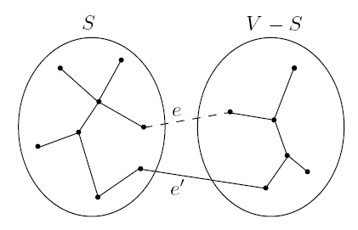
Cut Property: Assume edges X are part of an MST for G=(V,E). Pick any subset S for which X does not cross between S and V-S, and let e be the lightest edge across this partition. Then X ∪ {e} is part of some MST. – Why?
Assume edges X are part of a partial MST T (Inductive hypothesis)
If e is a part of T then done, so consider case where e is not part of T
Now add e to T, creating a cycle, meaning there must be another edge e' across the cut (S, V-S) (note that weight(e') ≥ weight(e))
Create T' by replacing e' with e: T' = T ∪ {e} – {e'}
T' is a tree since it is connected and still has |V|-1 edges
T' is an MST since:
weight(T') = weight(T) + w(e) – w(e')
both e and e' cross the cut (S, V-S)
by cut property e was the lightest edge across the cut
Therefore, w(e') = w(e) and T' is an MST
Thus, any (and only a) lightest edge across a cut will lead to an MST
Notes:
Not that great a proof

Slide 23
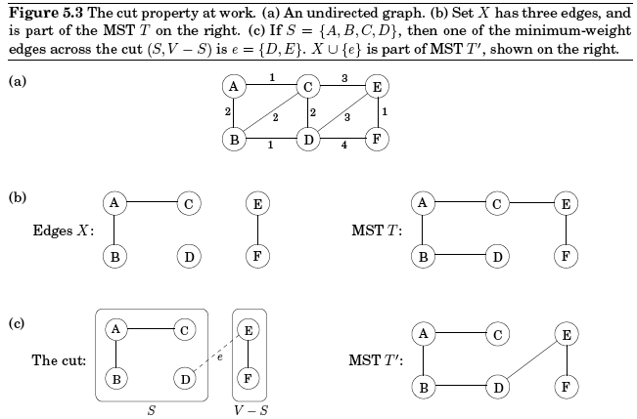
Cut Property
Which edge is e'?

Slide 24
Kruskal's Algorithm Implementation
Data structure represents the state as a collection of disjoint sets where each set represents a connected component (sub-tree) of G
Notes:
Save overall complexity for challenge question
Sort is ElogE or equivalently ElogV
can only be V-1 merges to be a tree, more would mean a cycle

Slide 25
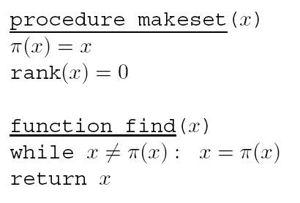
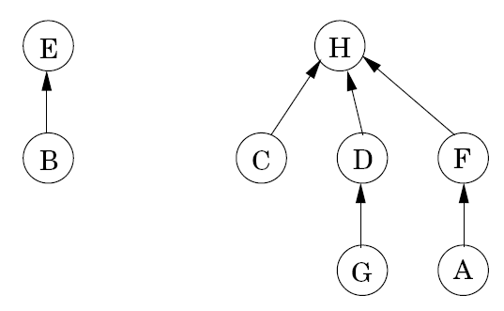
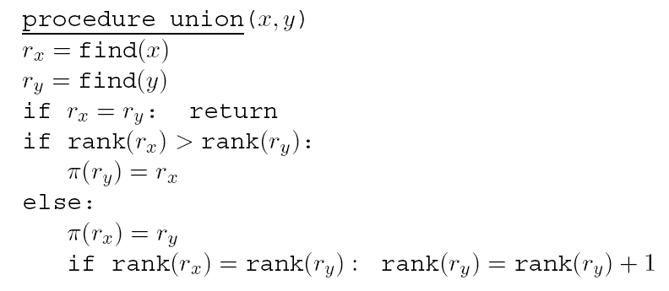
Directed Tree Representation of Disjoint Sets
Nodes are stored in an array (easy access) and have a pointer and a rank value
π(x) is a pointer to parent
if π(x) points to itself it is the root/name of the disjoint set
rank(x) is the height of the sub-tree rooted at node x
makeset is O(1)
find(x) returns the unique root/name of the set
union(x,y) merges sets to which x and y belong and keeps the tree balanced so that the maximum depth of the tree representing the disjoint set is log|V|
find and union complexity?
Notes:
*Do rank examples with H, D, and G.
*Do union B and D
Find and union are log|V|, Note Union could be O(1) for us since Kruskals already calls the two finds so those are not needed.
rx means root x
note arity of the tree not-problematic because only follow links up (no sorting going down, etc). – thus the wider the better
Only node that ever refers to or adjusts its rank is the root of the set, Note the E B subtree maintains correct rank with no update needed

Slide 26
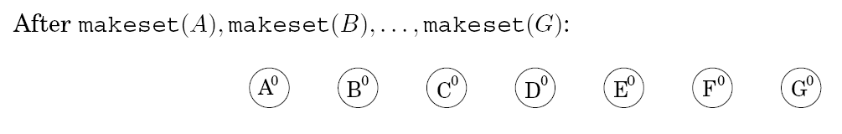
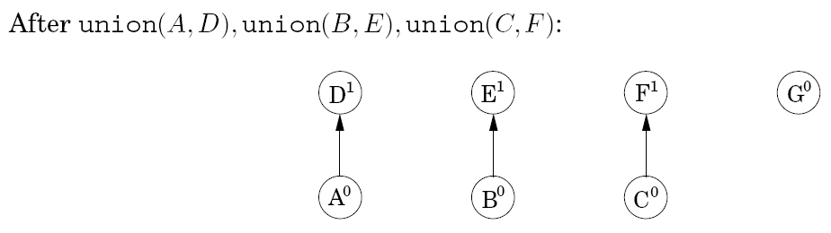
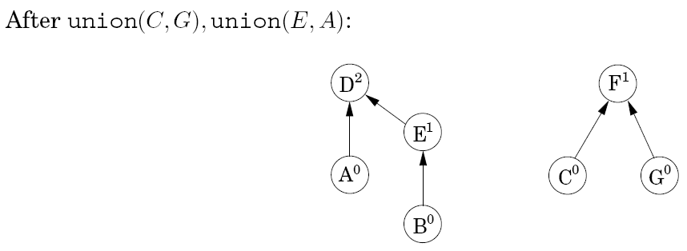
Node | π(x) | Rank
A | D | 0
B | E | 0
C | F | 0
D | D | 1
E | E | 1
F | F | 1
G | G | 0
Node | π(x) | Rank
A | D | 0
B | E | 0
C | F | 0
D | D | 2
E | D | 1
F | F | 1
G | F | 0

Slide 27
**Challenge Question** Kruskal's Algorithm
1. Given top image, show the new image and array representation after union(B, G)
2. What is the time and space complexity for Kruskal's algorithm with this data structure?
Notes:
Sort is ElogE or equivalently ElogV
can only be V-1 merges to be a tree, more would mean a cycle

Slide 28
Kruskal Algorithm Complexity
O(|E|log|V|) for initially sorting the edges
Sort is actually O(|E|log|E|)
Note that for a dense graph |E| ≈ |V|²
But remember that logn² = 2logn so they only differ by a constant factor and thus Θ(|E|log|V|) = Θ(|E|log|E|)
O(|V|) for the initial makesets – since each is O(1)
find(u): log|V| 2|E| times: O(|E|log|V|)
union(u,v): log|V| |V|-1 times (why?) – O(|V|log|V|)
Total complexity is O(|E|log|V| + |V|×makeset_complexity + |E|×find_complexity + |V|×union_complexity)
Total complexity: O(|E|log|V|)

Slide 29
Could compress depth during find. How?
Could do compression if we plan on using data structure a lot
Over time find would then have amortized O(1) complexity
Notes:
Show with find(B) on last image above. Could briefly mention compression as you go doing finds. In find, Set p(x) to the root found, thus flattening tree over time to depth one.
The root rank will end up being greater than reality, but who cares as the overall set keeps compressing to depth 1 regardless.

Slide 30
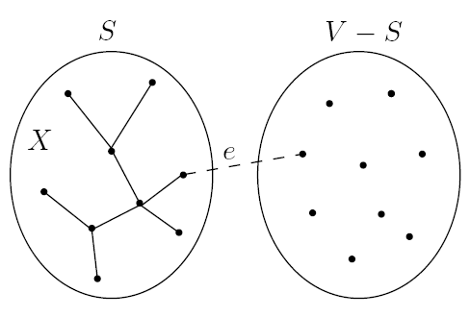
Prim's Algorithm
Prim's algorithm grows one SCC (X and S) as a single tree
X and S are the sets of intermediate edges and vertices in this partial MST
On each iteration, X grows by one edge, and S by one vertex
The lightest edge between a vertex in S and a vertex outside S (V - S)
All vertices S and V-1 edges must eventually move into S and X
Cannot create a cycle since new vertex not currently in S and we never add a new edge between two nodes already in S
What is an efficient data structure to retrieve that edge?
The algorithm is basically Dijkstra's algorithm except that the PQ key value for each node outside S is its lightest edge into S
Notes:
We just keep one SCC unlike Kruskals and this just have to make sure we never add an edge between 2 nodes already in our one growing SCC
All V will eventually get into the club. The next member is always the one with the cheapest ticke in (smallest edge key). Whenever a new member joins the club
Note X is a set of edges and S is a set of vertices
Argument of just checking if vertex is in X did not work for Kruskals because no fast way to test if edge is already in (e.g. O(v) scan) , whereas Prims does it by keeping vertices in PQ and once popped off, no .

Slide 31
Prim's Algorithm – An Intuitive Version
Consider each node as wanting to get into club S
All nodes must join the club and before we finish
Each non-member (V-S) has an entry key which is the smallest edge length from itself to any current member of the club
At each iteration the non-member with the smallest key joins the club
Whenever a new member joins the club, all non-members with edges to the new member have their key updated if their edge to the new member is smaller than their current smallest edge into the club
Notes:
We just keep one SCC unlike Kruskals and this just have to make sure we never add an edge between 2 nodes already in our one growing SCC
All V will eventually get into the club. The next member is always the one with the cheapest ticke in (smallest edge key). Whenever a new member joins the club
Note X is a set of edges and S is a set of vertices
Argument of just checking if vertex is in X did not work for Kruskals because no fast way to test if edge is already in (e.g. O(v) scan) , whereas Prims does it by keeping vertices in PQ and once popped off, no .

Slide 32
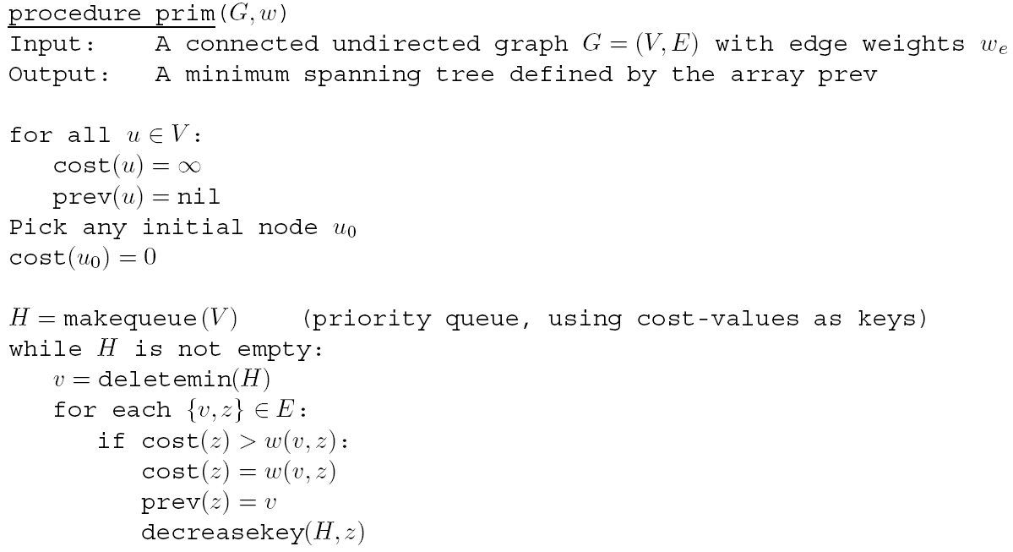
Prim's Algorithm
Decreasekey does not update path length, but updates the key with the decreased edge cost between v and z
Almost the same as Dijkstra's Algorithm, same complexity values
Notes:
Key is shortest edge of any node currently in S to any node in V-S
No need to sort first
There is a bug in above alg, since there is no dequeued flag, prev pointers can get sent back wrongly to a node already removed from the queue
Can show it on slide *** currently 37 (when node 2 looks down edge to node 1 and updates nodes 1's cost and prev ptr)
But not the best use of time so don't bring it up unless someone points it out.
Can stop after V-1 iterations – they just keep going

Slide 33
Prim’s Algorithm
Choose arbitrary starting vertex,
set to 0 and deletemin
1
2
1
2
3
S = {5}
1: ∞
2: ∞
3: ∞
4: ∞
5: 0
6: ∞
7: ∞
6
5
4
4
6
3
8
4
5
6
8
4
3
7
Notes:
Goal: Present Prim’s algorithm graphically in a manner similar to Kruskal’s algorithm.

Slide 34
Prim’s Algorithm
Choose arbitrary starting vertex,
set to 0 and deletemin
1
2
1
2
3
S = {5}
1: ∞
2: 4
3: 5
4: 3
6: 8
7: 8
6
5
4
4
6
3
8
4
5
6
8
4
3
7
Notes:
*PQ shows for each node outside S its shortest edge into S, and prev shows to which node the edge connects (so we can choose proper edge)
Goal: Present Prim’s algorithm graphically in a manner similar to Kruskal’s algorithm. Initially, consider the light blue edges leaving 5.

Slide 35
Prim’s Algorithm
deletemin returns node
with shortest edge into S
1
2
1
2
3
X:
S = {5}
{4,5}
S = {4,5}
1: ∞
2: 4
3: 5
4: 3
6: 8
7: 8
6
5
4
4
6
3
8
4
5
6
8
4
3
7
Notes:
Greedily chosen, this edge will be part of final solution. Don’t actually store S or X. Just follow final prev pointers from each node to get MST

Slide 36
Prim’s Algorithm
Don’t actually store S or X.
Final S is all V and we get MST using
prevs which are fixed once node dequeued.
PQ contains nodes not yet in MST (V – S)
1
2
1
2
3
X:
S = {5}
{4,5}
S = {4,5}
1: ∞
2: 4
3: 5
4: 3
6: 8
7: 8
6
5
4
4
6
3
8
4
5
6
8
4
3
7
Notes:
All nodes will be in final S. S-V is all nodes in PQ. Don’t actually store X either. Just follow back final prev pointers from each final node to get MST.
Prev is stable once node is dequeued, just like Dijkstra path length fixed once dequeued.

Slide 37
Prim’s Algorithm
Update then decreases keys in PQ
(shortest edge into S) where possible,
based on new node just added to S
1
2
1
2
3
X:
S = {5}
{4,5}
S = {4,5}
1: 4
2: 4
3: 5
6: 8
7: 4
6
5
4
4
6
3
8
4
5
6
8
4
3
7
Notes:
NOT path length, just cheapest one edge cost
Now consider any of the blue edges leaving 4 or 5. Etc. as we add more vertices. Node 7 cost is decreased.

Slide 38
Prim’s Algorithm
Repeat until PQ is empty
1
2
1
2
3
X:
S = {5}
{4,5}
S = {4,5}
2: 1
3: 5
6: 8
7: 4
6
5
4
4
6
{1,4}
S = {1,4,5}
3
8
4
5
6
8
4
3
7

Slide 39
Prim’s Algorithm
Repeat until PQ is empty
1
2
1
2
3
X:
S = {5}
{4,5}
S = {4,5}
3: 2
6: 8
7: 4
6
5
4
4
6
{1,4}
S = {1,4,5}
3
8
{1,2}
S = {1,2,4,5}
4
5
6
8
4
3
7
Notes:
Skip this unless brought up, as it is not the best use of time.
***Note in this case when node 2 checked node 1 which has a key of 4 it would update the cost to 1 (not big deal) AND prev pointer of node 1 would change to node 2 which would be a bug.
Should only test with nodes still on the queue. If added edge immediately into X rather than prev tree at end would have been fine.

Slide 40
Prim’s Algorithm
Repeat until PQ is empty
1
2
1
2
3
X:
S = {5}
{4,5}
S = {4,5}
6: 6
7: 4
6
5
4
4
6
{1,4}
S = {1,4,5}
3
8
{1,2}
S = {1,2,4,5}
4
5
6
{2,3}
S = {1,2,3,4,5}
8
4
3
7

Slide 41
Prim’s Algorithm
Repeat until PQ is empty
1
2
1
2
3
X:
S = {5}
{4,5}
S = {4,5}
6: 3
6
5
4
4
6
{1,4}
S = {1,4,5}
3
8
{1,2}
S = {1,2,4,5}
4
5
6
{2,3}
S = {1,2,3,4,5}
{4,7}
S = {1,2,3,4,5,7}
8
4
3
7

Slide 42
Prim’s Algorithm
Repeat until PQ is empty
1
2
1
2
3
X:
S = {5}
{4,5}
S = {4,5}
6
5
4
4
6
{1,4}
S = {1,4,5}
3
8
{1,2}
S = {1,2,4,5}
4
5
6
{2,3}
S = {1,2,3,4,5}
{4,7}
S = {1,2,3,4,5,7}
8
4
3
{6,7}
S = {1,2,3,4,5,6,7}
7

Slide 43
Complexity
Dense Graph: |E| = O(|V|²)
Kruskal’s: Θ(|E| log |V|) = Θ(|V|² log |V|)
Prim’s (w/ Array PQ): Θ(|V|²)
Prim’s (w/ Binary Heap PQ): Θ(|E| log |V|) = Θ(|V|² log |V|)
Sparse Graph: |E| = O(|V|)
Kruskal’s: Θ(|E| log |V|) = Θ(|V| log |V|)
Prim’s (w/ Array PQ): Θ(|V|²)
Prim’s (w/ Binary Heap PQ): Θ(|E| log |V|) = Θ(|V| log |V|)
Punch-lines
Prim’s with Array PQ is best for a dense graph
Kruskal’s with sets OR Prim’s with Heap PQ are both about the same for sparser graphs
Kruskal’s gives more control when choosing between edges with ties in cost and some consider Kruskal’s as easier to implement
Notes:
remember last log|V| = θ(log|V|²⁾
Prim's always better? Constant factor issues
Why isn't Prims (V+E)logV llike Dijktras? – because nodes are all connected so E >= V
Dijsktra’s both greedy and DP, though Prims follows the more common greedy flavor of pick one of current set of options on the way to a goal.
Other considerations – Kruskals leads to easy stochastic minimum cut algorithm. Last edge added is highly likely the minimum cut
Length tie advantage as Prims has edge is PQ and you just get to see the edge that the PQ has at front, but you see all tied edges with Kruskals

Slide 44
Huffman Encoding
Commonly used algorithm
Example: MP3 audio compression which works as follows
Digitize the analog signal by sampling at regular intervals
Yields real numbers s₁, s₂,…, s_{T}
High fidelity is 44,100 samples per second
Thus a 50 minute symphony would have T = 50·60·44,100 ≈ 130 million samples
Quantize each sample s_{t} into a finite alphabet Γ
These are called codewords or symbols
e.g. Quantize into 16 bit numbers
Sufficient that close codewords are indistinguishable to human ear
Encode the quantized values into binary numbers
Huffman coding (compression) can give savings in this step
Notes:
greek letter is cap Gamma

Slide 45
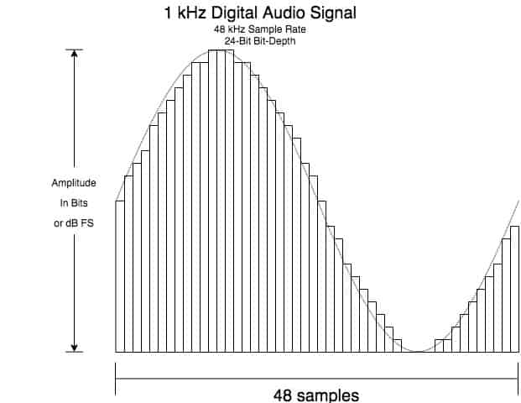
Huffman Encoding

Slide 46
Huffman Encoding
Assume an example of 130 million samples, and that the alphabet has 4 codewords: A, B, C, D
Thus all measurements are quantized into one of 4 values
Encode these into binary
A: 00
B: 01
C: 10
D: 11
Total memory would be 260 million bits (2 bits/sample)
Can we do better?

Slide 47
Huffman Encoding
Consider the frequency (count) of the symbols: A, B, C, D
A: 70 million
B: 3 million
C: 20 million
D: 37 million
Could use a variable length encoding where more common codewords are represented with less bits?
A: 0
B: 001
C: 01
D: 10
Total number of bits would now be less due to frequency of A
However, how would you distinguish AC from B?

Slide 48
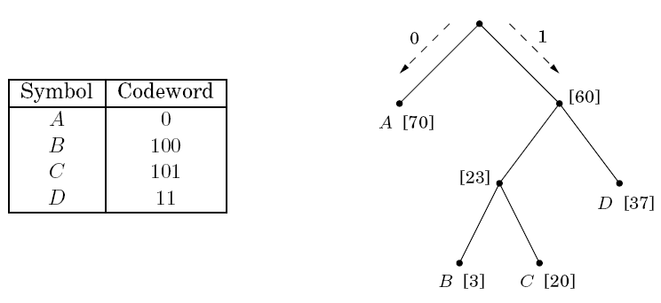
Prefix-Free Property
Prefix-Free Property: A binary representation of codewords such that no codeword can be a prefix of another codeword
Any full binary tree (all nodes have 0 or two children) with the #leafs equal to the #codewords will always give a valid prefix free encoding
Any codeword can arbitrarily be at any leaf, but we want more frequent codewords higher in the tree
Encoding below allows us to store our example with 213 Mbits – Why? (17% improvement)
But how do we find an optimal encoding tree? – Simple Alg?
Notes:
What are some other valid encoding trees for our 4 symbol problem?
Could put symbols on different leafs but only gets worse to move more frequent down
First swap BC subtree with D (no real change, just change in codeword values)
Note that only 2 trees are truly unique for this problem since codeword bits are arbitrary, Need 5 leafs to get 3rd variety, grow exponentially

Slide 49
Optimal Encoding Tree
Assume frequency (count) of codewords are f₁, f₂, …, f_{|Γ|}
Treecost = 70·1 + 37·2 + 3·3 + 20·3 = 213
Rather than 2 bits per sample we have
1*70/130 + 2*(37/130) + 3*((20 + 3)/130) = average 1.64 bits per sample
Notes:
depth in tree is number of bits required for that code (thus increased cost with depth)
note how 3 is counted 3 times, 37 is counted 2 times, etc.
But there are an exponential number of tree possibilities. How do we find optimal?

Slide 50
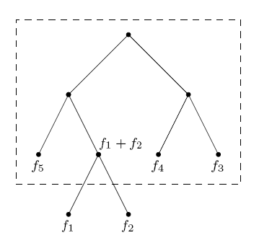
Huffman Algorithm
Greedy constructive algorithm
Repeat until all codewords are used
Pull the two codewords with the smallest f_{i} and f_{j} off the list of frequencies
Make them children of a new node with frequency f_{i} + f_{j}
Insert f_{i} + f_{j} into the list of frequencies – What data structure?
Tree must have exactly 2n-1 nodes; n leafs and n-1 internal nodes
Notes:
PQ! Can't just sort frequencies because we will be adding new ones in
Try it on an example of our own, Do previous example on next page

Slide 51
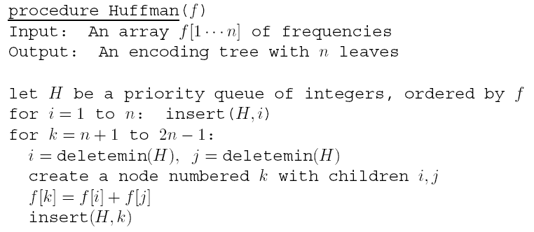
Huffman Algorithm
Although we insert array indexes (integers from 1 to 2n-1) into the queue, the priority queue key value is f(index)
Note the array f is assumed unsorted (e.g. 70, 3, 20, 37)
Can implement priority queue just like in Dijkstra's algorithm (but don’t need decreasekey)
Notes:
Try it on our example problem. Must be 2n-1 total nodes (internal and leaf) in the final tree. First n in array will be the leaf nodes, last n-1 the internal nodes
The array indexes give us a simple way to hame/number all our tree nodes. Use those numbers when building up tree on board, but write the letter name and frequencies with them also
They use indexes in the PQ so that we can know the numbers of the children to the new internal node
Don’t do complexity, save for challenge question
Array of frequencies does NOT have to be sorted (PQ will take care of getting out smallest)
Array is not tree implementation. It is just a tool to help us build the tree.
Second loop creates the n-1 internal nodes each with 2 children, n of which will be the leaf codewords

Slide 52
**Challenge Question** Huffman Algorithm
Using Huffman show a final tree, tree cost, and encoding given:
A: 10
B: 5
C: 15
D: 5
E: 40
If we use a binary heap implementation for the priority queue, then what is Huffman time and space complexity?
Notes:
Try it on our example problem. Must be 2n-1 total nodes (internal and leaf) in the final tree.
Array of frequencies does NOT have to be sorted (PQ will take care of getting out smallest)
Array is not tree implementation. It is just a tool to help us build the tree.

Slide 53
Huffman Algorithm
If we use a binary heap implementation for the priority queue, then Huffman complexity is O(nlogn) and space complexity is O(n)
Notes:
2n-1 inserts and deletemins

Slide 54
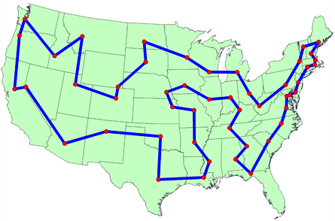
Travelling Salesman Problem
Given a set of n cities with distances from one city to another:
Visit each city exactly once, and return to the initial city
Travelling the least possible distance
What is the simplest algorithm to make sure we get the optimal result?
Notes:
What is the simple algorithm?
Show why it is n!
n possibilities as 1st, for each of those n-1 possibilities for second city, for each of those n-2 for third, etc = n! All possible permutations

Slide 55
TSP Complexity
There are n! possible paths
To calibrate, there are about 10⁵⁷ atoms in the solar system and 10⁸⁰ atoms in the current known universe
Approximate TSP Time Complexity – big O
# of Cities | Brute force O(n!)
10 | 10⁶
15 | 10¹²
20 | 10¹⁸
50 | 10⁶⁴
100 | 10¹⁵⁹
1000 | 10²⁵⁶⁷
Notes:
Test all paths

Slide 56
TSP Greedy Approach
What is a greedy algorithm to find a TSP path?
Will it be optimal?
What is its complexity?
Notes:
Put some cities on the board and figure out the algorithm

Slide 57
TSP Greedy Approach
What is a greedy algorithm to find a TSP path?
Start at an arbitrary city
Choose shortest edge from current node to an unvisited city, O(n)
Repeat process from the most recently visited city
Finally, connect the last city to the first city
Total O(n²)
You will implement this as a baseline comparison to improve against with your own algorithm in the group TSP project (more later)
2nd Order Greedy
Shortest combined path from current city which reaches two cities
Complexity?
Is it better?
Group project, start thinking about approaches
Notes:
Talk a bit more about the group approach. Get greedy up right away, start looking at approaches, still lots of paradigms we haven't covered so don't have to decide too fast.
Give them a few minutes to exchange e-mails, etc.
n^2 for greedy, and n^3 for 2nd order greedy.
However 2nd order greedy only better about half the time, and worse the rest thus we don't do it. Unusual, but for a highly intertwined problem like TSP too much greedy can get you in trouble for later, leaving long paths to connect sub-clusters

Slide 58
Horn Formulas
Can use rules and settings of variables to solve interesting problems – PROLOG – early AI language
Assume a set of Boolean variables
r = it is raining
u = umbrella is open
d = you are dry
Horn formulas are made of implications (i.e. rules)
(r ∧ u) ⇒ d
and pure negative clauses (another type of rule)
(¬r ∨ ¬u ∨ ¬d) – At least one of the variables must be false
Can we find an assignment of our variables which satisfies all our rules, and also infers new information
Notes:
It's raining and I'm dry does that infer that umbrella must be open?
Implications have all positive literals.
Not equivalent to 2-SAT, though both polynomial.
Horn formulas equivalent to CNF where all clauses contain at most one positive literal

Slide 59
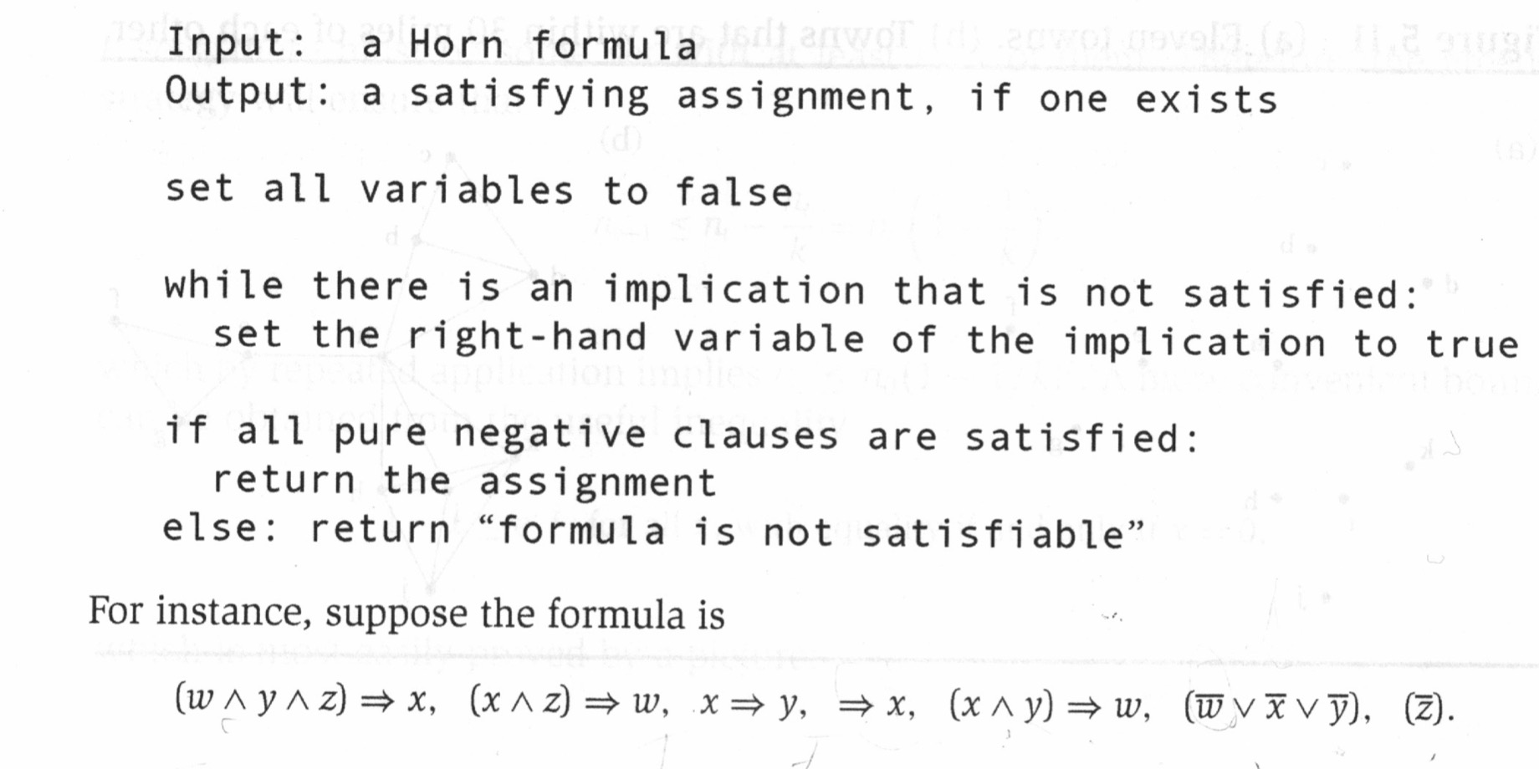
Horn Formulas Greedy Algorithm
Modus
Ponens
p | q | p→q
F | F | T
F | T | T
T | F | F
T | T | T
4 variables, 7 clauses, 17 literals
Gives correct solution and you can implement the above with a variation linear in the number of literals (See HW 5.33)
Notes:
Greedy in the sense that it flips a variable just to make this single clause happy, without look at the effect on the full set of clauses.
Greedily and stingily only change enough to true to satisfy the implications, and then hope enough are left false to satisfy the pure negative clauses
Walk through example – Put variables on board with initial false value. Once set something to true, can’t set back to false.
Can’t trivially go in any order. Show Logical version and that’s all. x must be true (->x, assumes left side is true), which implies y must be true since x->y, and w is true by 5th clause, 1st and 2nd clause are satisfied with no further change since consequents (x and w) are true,
Then we look at the pure negative clauses. The last one is satisfied since z is already false, the next to last is not satisfied since x, y, and w all set to true thus no solution
Would have gotten same result if tried another order, try it going left to right, however would have to loop through it multiple times to see if implications still true after each implication update O(n^2). Book HW approach uses graph rep and counters.

Slide 60
Satisfiability
Horn-SAT is one variation of Satisfiability
2-SAT
(x ∨ y) ∧ (¬z ∨ x) ∧ (w ∨ y) ∧ …
SAT problems: does there exist a setting of the Boolean variables which satisfy this formula, 2-CNF
There is a polynomial solution
3-SAT
(x ∨ y ∨ p) ∧ (¬z ∨ x ∨ q) ∧ (w ∨ y ∨ q) ∧ …
There is a no polynomial solution, one of original NP-complete problems

Slide 61
Set Cover
Assume a universe U of elements
Assume a set S of subsets S_{i} of the universe
Set Cover is the problem of finding the minimum number of the subsets, whose union includes all elements of the universe – Very common in real world problems (e.g. airline crew scheduling)
U = {1, 2, 3, 4, 5}
S = {{1, 2, 3}, {2, 4}, {3, 4}, {4, 5}}
What is the minimum set cover in this case?
Greedy Algorithm?
Is it optimal?
Notes:
Could try all possible subsets of S: 2^n
Until all elements in U covered, Select Si with the largest number of uncovered elements
Our greedy is optimal for this example

Slide 62
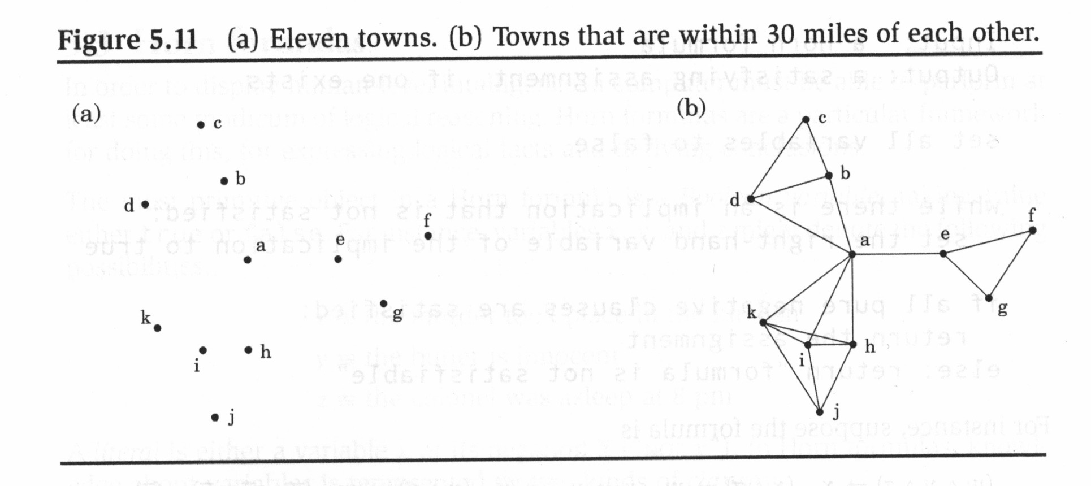
Set Cover Example
In which towns should we place schools given that all towns must be within 30 miles
of a school. Each town has edges to those towns who are within 30 miles.
Each town represents one of n subsets of towns (i.e. those to whom they are directly connected)
Until all elements in U covered, select S_{i} with the largest number of uncovered elements.
Notes:
n subsets in this case, each city represents subset of cities within 30 miles (shown by edges in graph)
Thus c has size 3 (2 edges plus self), e has size 4 (3 edges plus self)
a, then f or g, then c, then j
Is it optimal?
Optimal would have been {i or k or h, b or d, e}

Slide 63
Set Cover
Set Cover is another NP-complete problem, thus there exists no polynomial solution to find the optimum
We can show that our simple greedy algorithm gives an answer within ln(n) of the optimal solution
Thus, if k is the optimal solution, our simple greedy algorithm is guaranteed to find a value between k and kln(n)
ln(n) is the approximation factor
There is provably no polynomial time algorithm for Set Cover with a smaller approximation factor

Slide 64
Machine Learning and Decision Trees
In machine learning we want to take data sets with examples of classifications and learn so that we can generalize good answers when we later receive new unforeseen data
Medical diagnosis, stock market prediction, speech recognition, self-driving cars, etc.
Decision trees are learned using a greedy divide-and-conquer algorithm and obtain very good results
Notes:
Give an initial ML intro with a heart attack data set which we will continue in a minute, HR, Pain level, BP, Arm numbness (Y/N), etc.
Start with a picture on the board of data in root and how we could divide and conquer in a greedy way

Slide 65
Decision Tree Learning – Pizza Classification
Assume A₁ is binary feature (Veggie, Meaty)
Assume A₂ is 3 value feature (Crust: Thin/Stuffed/Thick)
Circles are good pizzas and Squares are great pizzas
A goal is to get “pure” leaf nodes. What do we do?
Thin
Stuffed
Thick
A₂
A₁
Veggie Meaty

Slide 66
Decision Tree Learning
Assume A₁ is binary feature (Veggie, Meaty)
Assume A₂ is 3 value feature (Crust: Thin/Stuffed/Thick)
Circles are good pizzas and Squares are great pizzas
Greedily divide on attribute which gives the purest children
A₁
Thin
Stuffed
Thick
Thin
Stuffed
Thick
A₂
A₂
A₁
Veggie Meaty
A₁
Veggie Meaty
Notes:
Often use low entropy as the measure of purity

Slide 67
Decision Tree Learning
Assume A₁ is binary feature (Veggie, Meaty)
Assume A₂ is 3 value feature (Crust: Thin/Stuffed/Thick)
Circles are good pizzas and Squares are great pizzas
Greedily divide on attribute which gives the purest children
A₁
A₂
Thin
Stuffed
Thick
Thin
Stuffed
Thick
A₂
A₂
A₁
Veggie Meaty
A₁
Veggie Meaty

Slide 68
Decision Tree Learning
Assume A₁ is binary feature (Veggie, Meaty)
Assume A₂ is 3 value feature (Crust: Thin/Stuffed/Thick)
Circles are good pizzas and Squares are great pizzas
Greedily divide on attribute which gives the purest children
A₁
A₂
Thin
Stuffed
Thick
Thin
Stuffed
Thick
A₂
A₂
A₁
Veggie Meaty
A₁
Veggie Meaty

Slide 69
Conclusion on Greedy Algorithms
Leads to optimal solutions for a number of important problems
MST, Huffman, Horn Formulas, etc.
Often do not lead to optimal solutions, but very powerful and common approximation approach for otherwise exponential tasks
TSP, Decision trees, Set Cover, etc.
Usually lead to relatively simple and efficient algorithms, avoiding expensive look ahead

